Slide 1
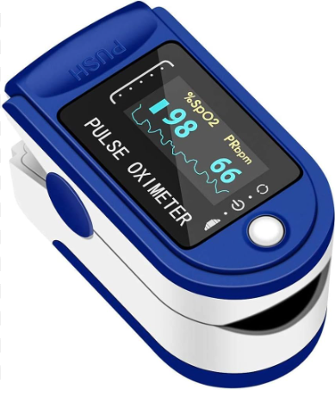
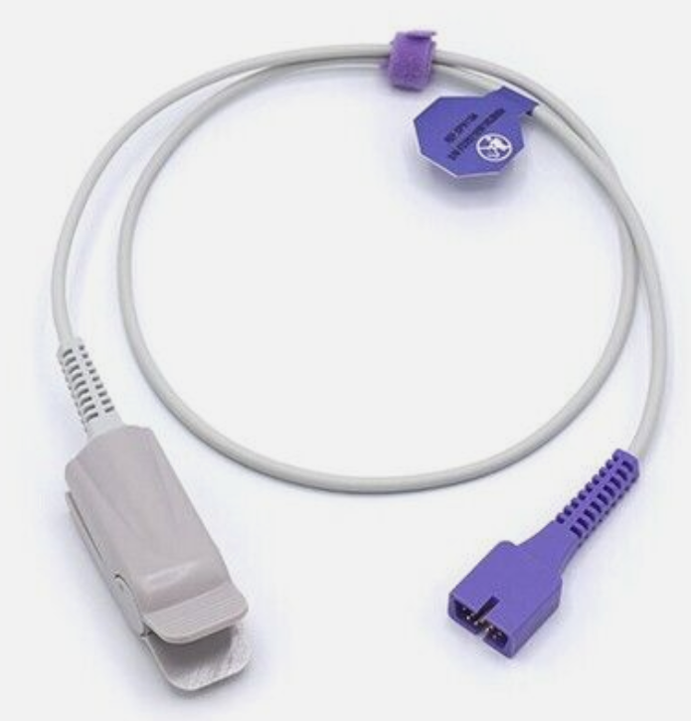
Lab Director: Dr. ShIANG-Hwua Yu 余祥華
Pulse Oximeter Project (脈搏血氧儀製作專題)
【 Function 】Detect finger pulse and blood oxygen concentration
偵測手指脈搏及血氧濃度
【 Design 】 Analog circuit & FPGA signal processing & estimation
類比電路及FPGA信號處理及估測
Infrared LED and sensing circuit
Analog-to-digital conversion
Digital filter
Pulse rate estimation and blood oxygen estimation
Display

